Slide 1
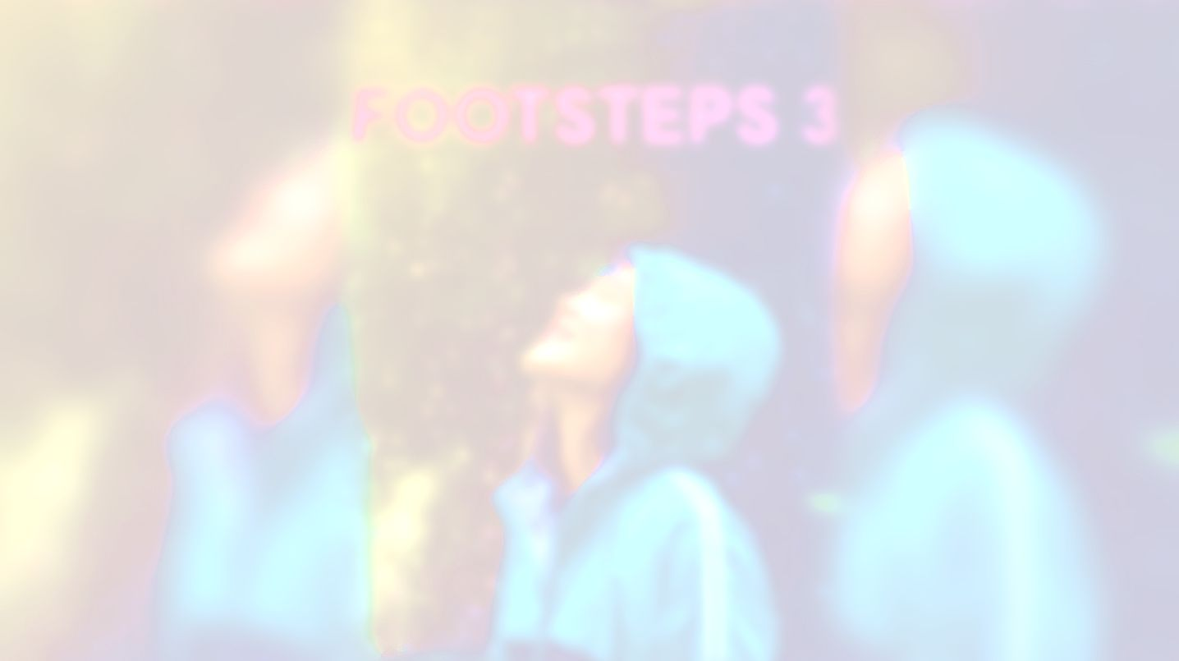


UNIT 6;
Created to create
Self-check 6

Slide 2
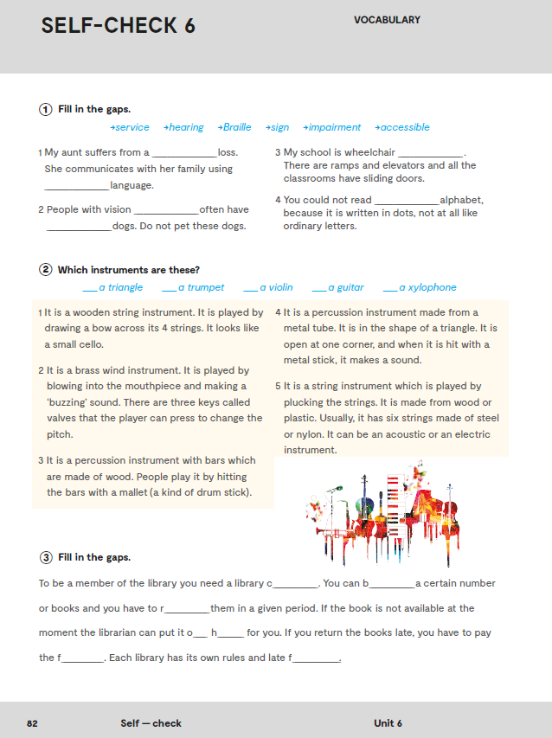
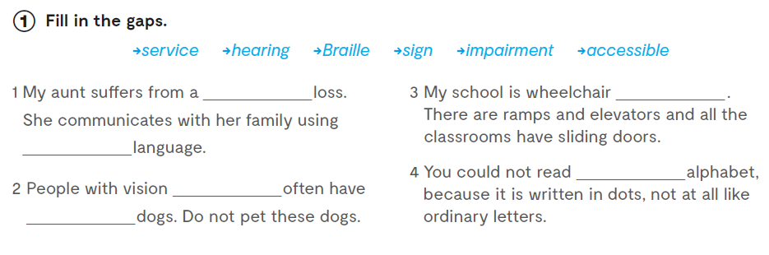
Workbook, p. 68
hearing
accessible
sign
Braille
impairment
service

Slide 3
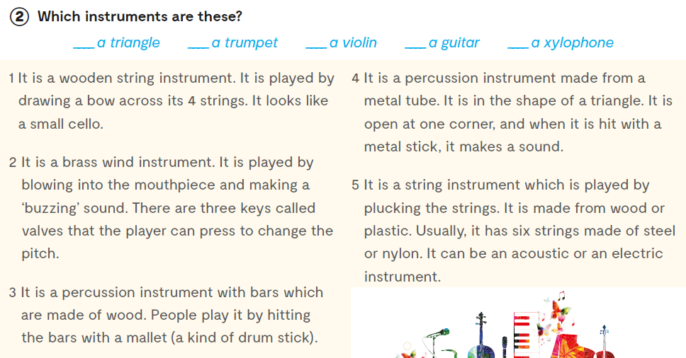
4
2
1
5
3

Slide 4
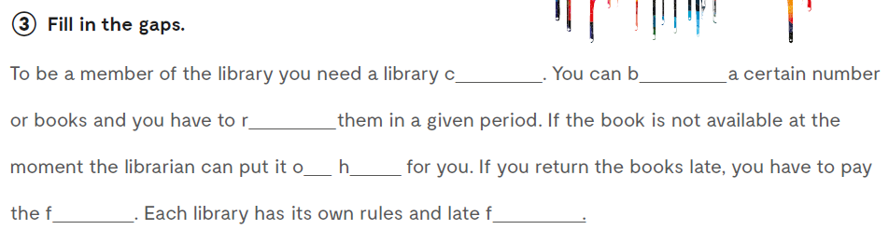
orrow
ard
eturn
ine
n old
ees

Slide 5
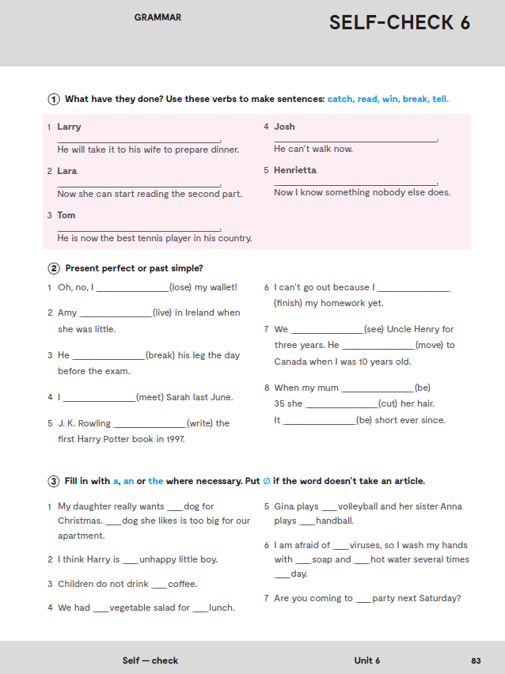
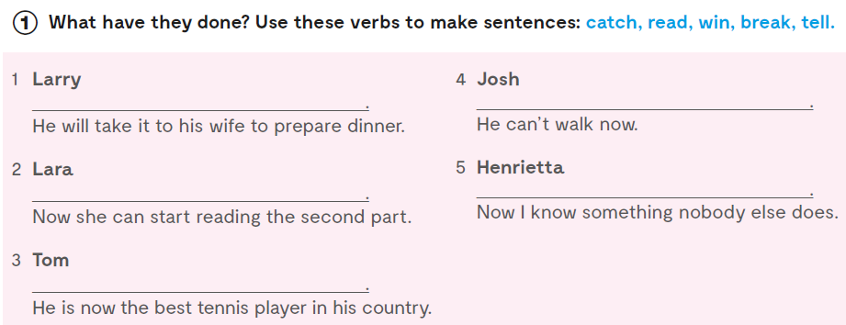
Put the verbs in brackets in the present perfect tense.
Larry has caught a fish
Josh has broken his leg
Lara has read the first part of the book.
Henrietta has told me a secret
Tom has won the tennis championship.

Slide 6
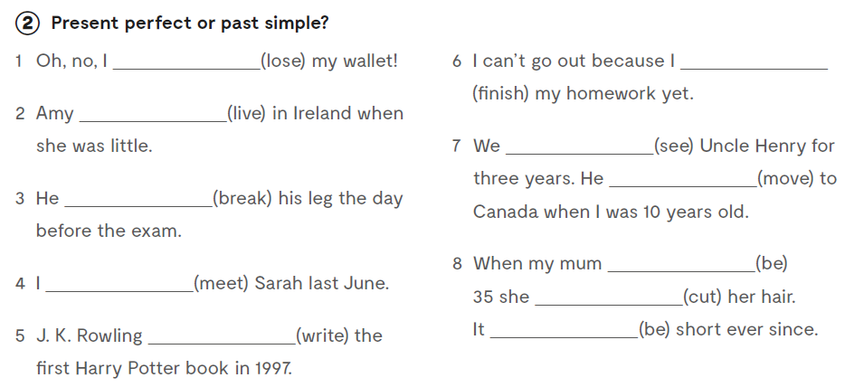
have lost
haven’t finished
lived
haven’t seen
moved
broke
was
met
cut
wrote
has been

Slide 7
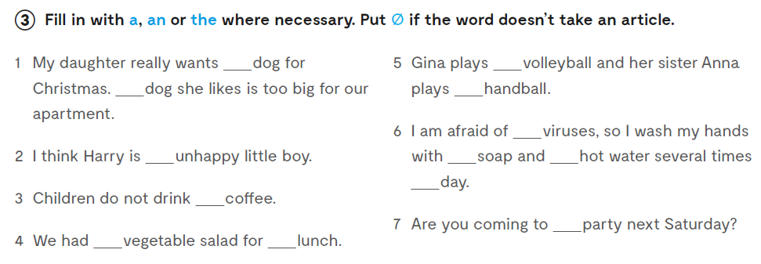
a
Ø
The
Ø
Ø
an
Ø
Ø
a
Ø
the
a
Ø
Let’s practise:
https://wordwall.net/play/889/951/237
https://wordwall.net/play/890/069/691

Slide 8
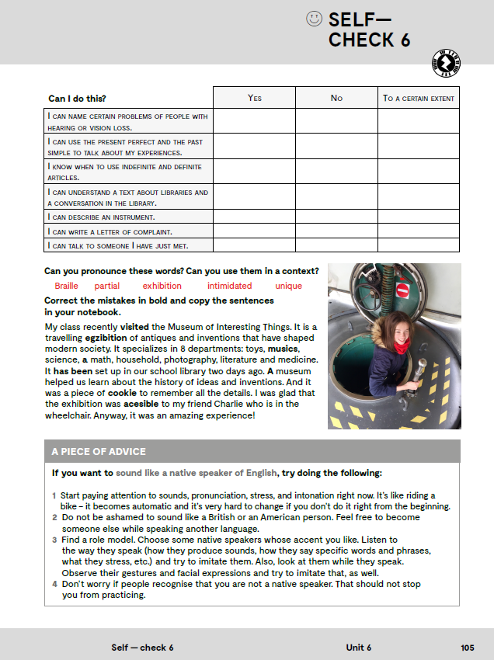


Slide 9
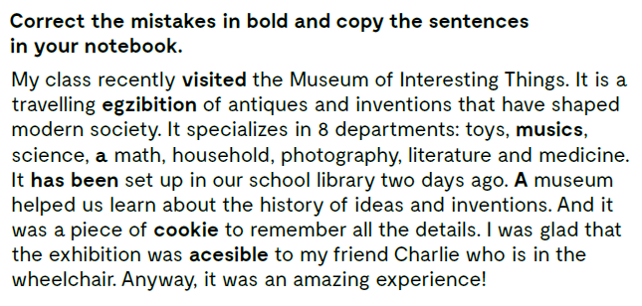
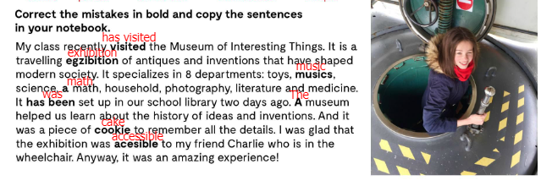

Slide 10
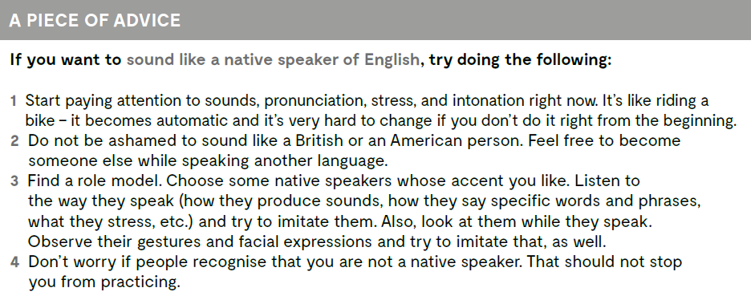

Slide 11
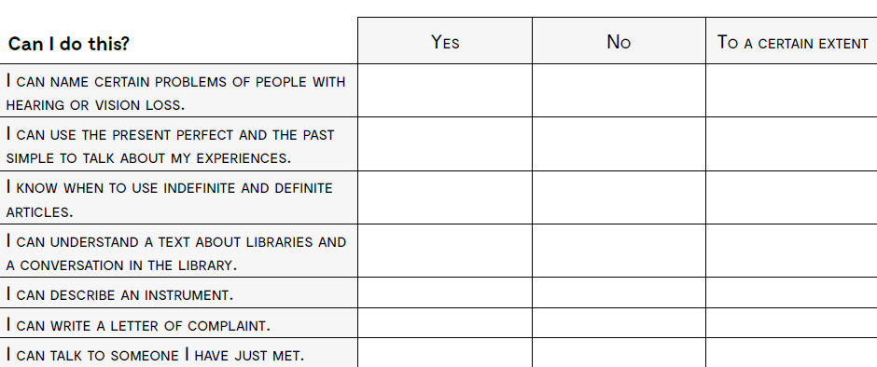
imenovati izazove osoba s oštećenjima vida i sluha?
koristiti Present Perfect i Past Simple kada govorim o svojim
iskustvima?
ispravno koristiti članove?
razumjeti tekst o knjižnicama i razgovor u knjižnici?
opisati glazbeni instrument?
napisati pismo pritužbe?
razgovarati s nekim koga sam po prvi put upoznao?

